Slide 1

Customer Shopping Behavior Analysis
Uncovering insights from transactional data to guide strategic business decisions.

Slide 2

Project Scope & Data Summary
Project Goal
Key Features (18 Columns)
Analyze 3,900 purchases to uncover spending patterns, customer segments, product preferences, and subscription behavior.
Customer
Purchase
Age, Gender, Location, Subscription Status
Item, Category, Amount, Season, Size, Color
Data includes demographics, purchase details, and shopping behavior metrics.
Behavior
Discount, Promo Code, Previous Purchases, Review Rating

Slide 3





Exploratory Data Analysis (Python)
Initial steps focused on data preparation and cleaning.
Data Loading & Exploration
Imported dataset and checked structure/summary statistics.
Data Cleaning
Imputed 37 missing Review Ratings using median per category.
Feature Engineering
Created age_group and purchase_frequency_days columns.
Database Integration
Loaded cleaned data into PostgreSQL for SQL analysis.

Slide 4
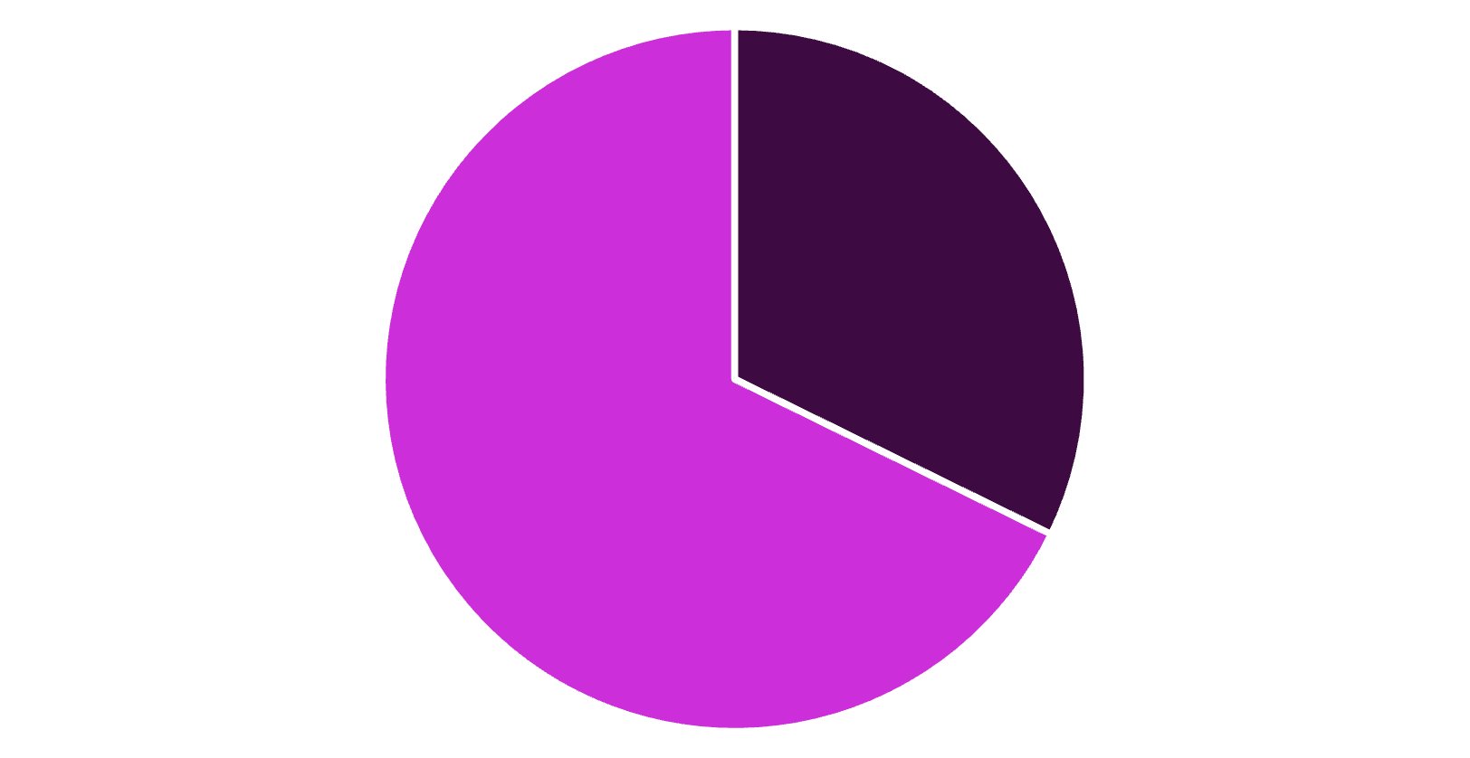
Revenue & Spending by Gender
Analysis of total revenue generated by male vs. female customers.
$157,890
$75,191
Male Revenue
Female Revenue
Significantly higher total revenue contribution.
Represents a smaller portion of total sales.
Male customers generated more than double the revenue of female customers.
Female
Male

Slide 5
Product Performance & Ratings
Top 5 Products by Average Rating
Discount-Dependent Products
Item Purchased
Avg. Rating
Products with the highest percentage of discounted purchases:
Gloves
3.86
50.00%
Sandals
3.84
Hat
Boots
3.82
49.66%
Hat
3.80
Sneakers
Skirt
3.78
49.07%
Gloves and Sandals lead with the highest customer satisfaction scores.
Coat
48.17%
Sweater
47.37%
Pants

Slide 6


Shipping & Subscription Impact
Express Shipping
Standard Shipping
Average purchase amount: $60.48
Average purchase amount: $58.46
Subscribers (Yes)
Non-Subscribers (No)
Avg. Spend: $59.49 | Total Revenue: $62,645
Avg. Spend: $59.87 | Total Revenue: $170,436
Express shipping users spend slightly more. Non-subscribers drive the majority of total revenue due to higher volume (2,847 customers).

Slide 7
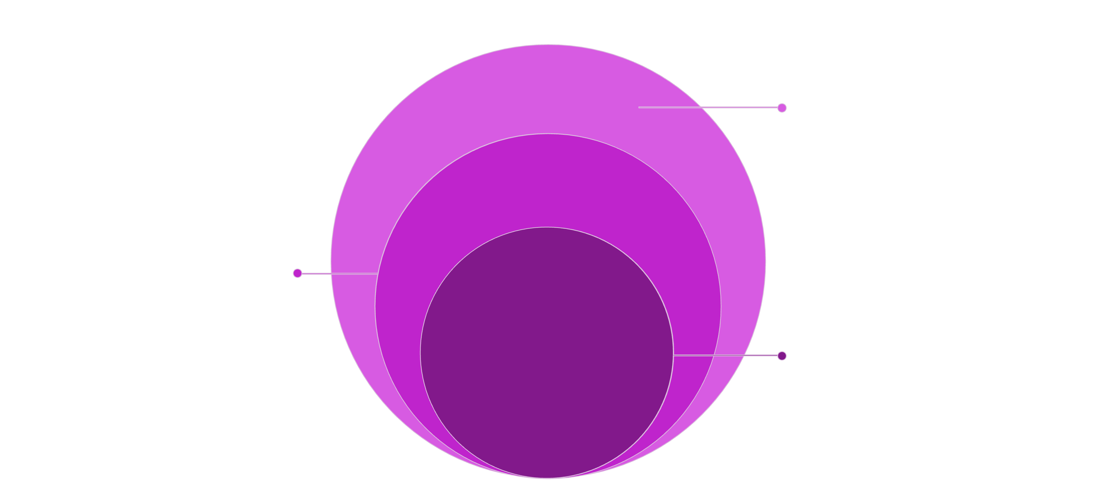
Customer Segmentation
Classifying customers based on purchase history reveals a highly loyal base.
New
Smallest segment, early-stage engagement
Returning
Repeat buyers with growth potential
Loyal
Largest segment, strong retention and value
3,116
701
83
Loyal Customers
Returning Customers
New Customers
The largest segment, indicating strong retention.
Opportunity to convert to Loyal status.
Smallest segment; focus on acquisition.

Slide 8




Top Products by Category
Identifying the most purchased items within the core categories.
Accessories
Clothing
Footwear
Outerwear
Jewelry, Sunglasses, Belt
Blouse, Pants, Shirt
Sandals, Shoes, Sneakers
Jacket, Coat

Slide 9
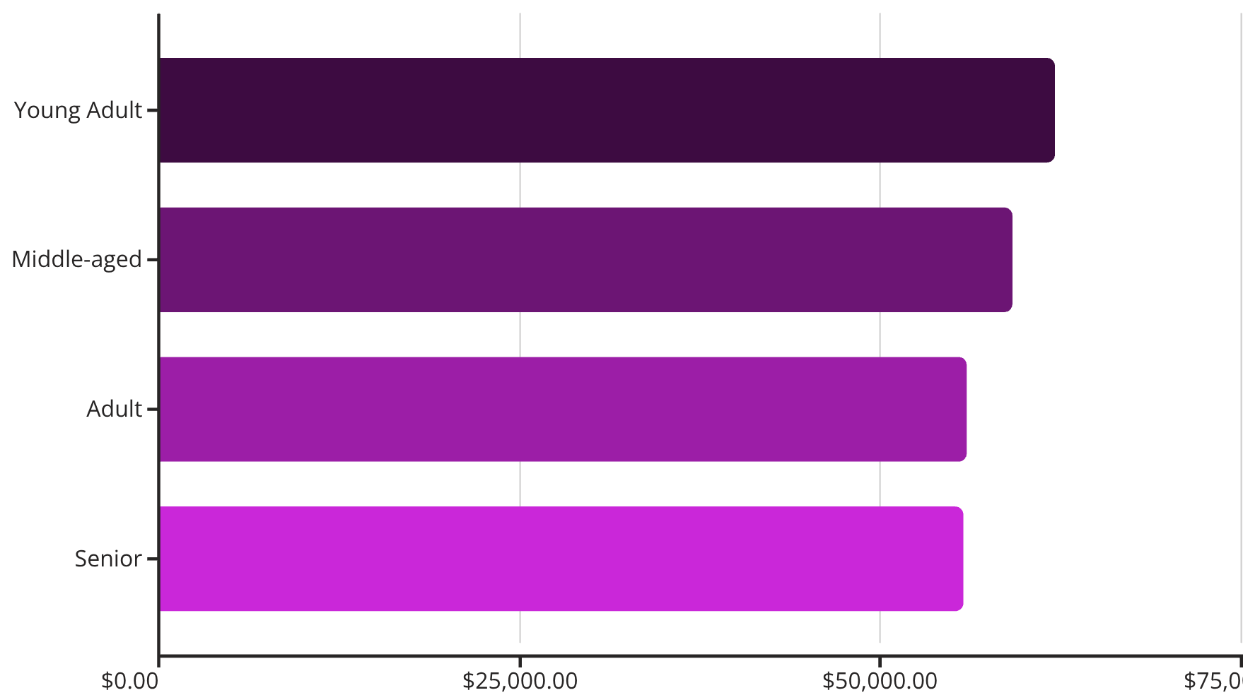


Age Group Revenue & Loyalty
Revenue by Age Group
Repeat Buyers & Subscriptions
Are customers with >5 purchases more likely to subscribe?
73.5%
Non-Subscribers
Repeat buyers who have not subscribed (2,518 customers).
26.5%
Subscribers
Repeat buyers who are also subscribers (958 customers).
Young Adults are the highest revenue-generating group.

Slide 10

Strategic Business Recommendations
Boost Subscriptions
Customer Loyalty
Promote exclusive benefits to convert repeat buyers and non-subscribers.
Reward repeat buyers to solidify the "Loyal" customer segment.
Review Discount Policy
Targeted Marketing
Balance sales boosts with margin control, especially for discount-dependent products.
Focus efforts on high-revenue age groups (Young Adults) and express-shipping users.

